Slide 1

Notes:
Time: 0:00-0:30

Slide 2
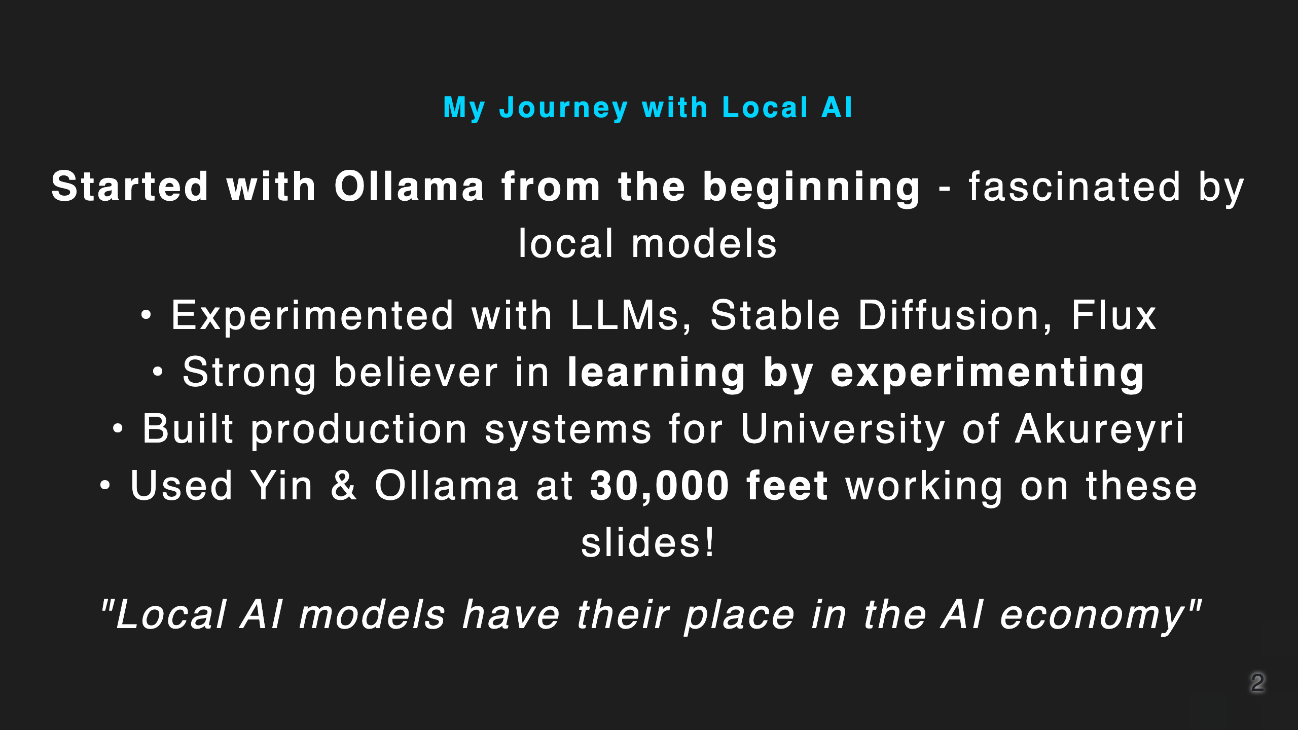
Notes:
Time: 0:30-1:30

Slide 3
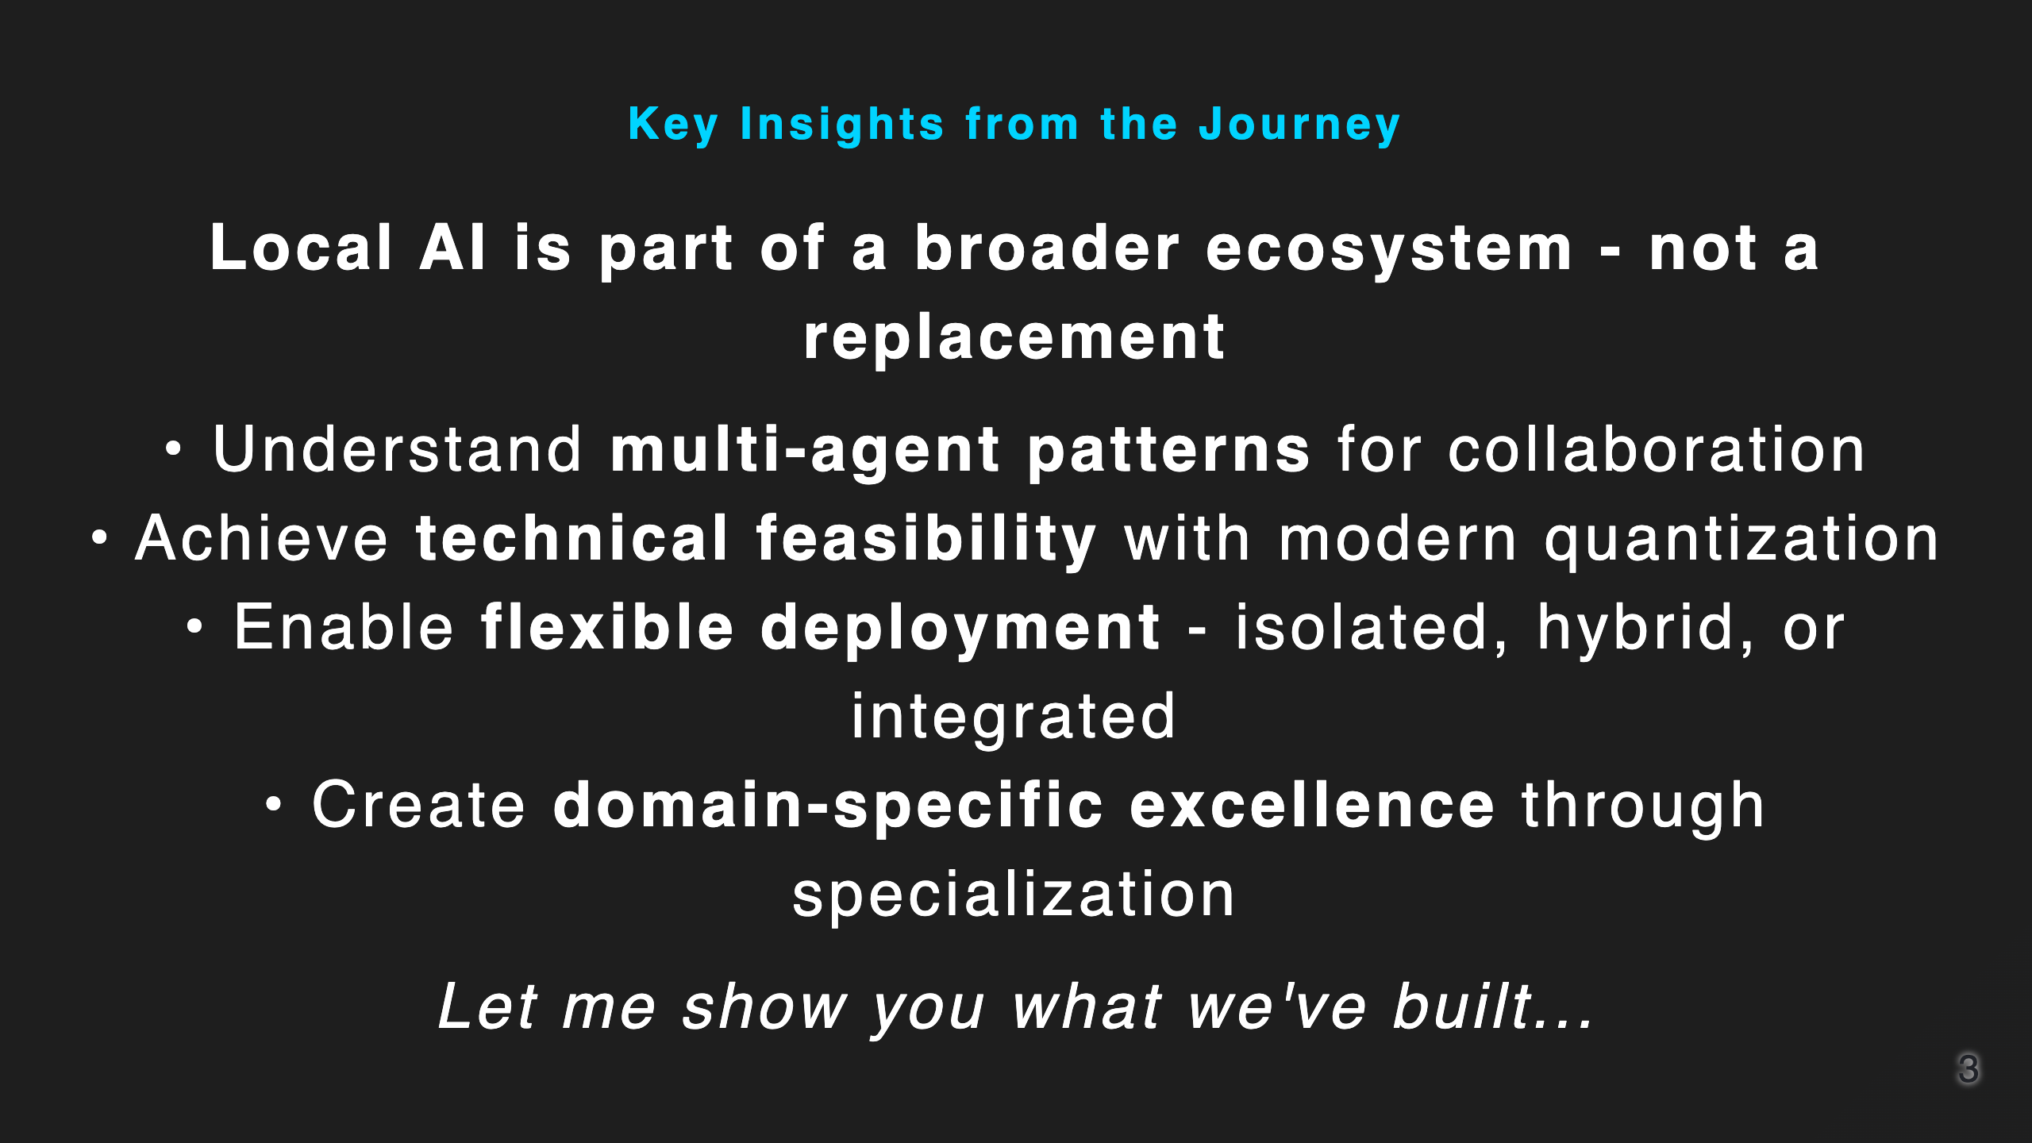
Notes:
Time: 1:30-2:30

Slide 4

Notes:
Time: 2:30-4:00 This slide will be moved to the end as requested

Slide 5
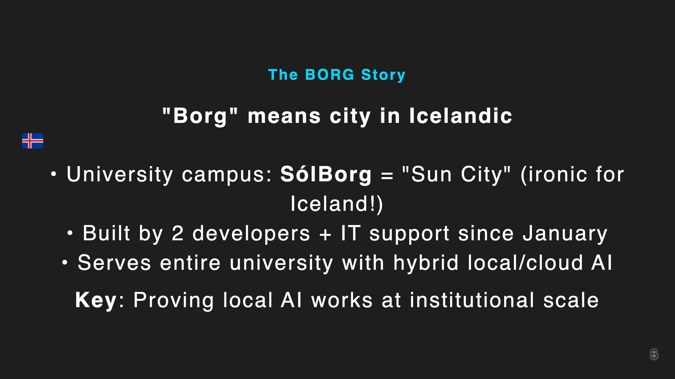
Notes:
Time: 4:00-5:00

Slide 6
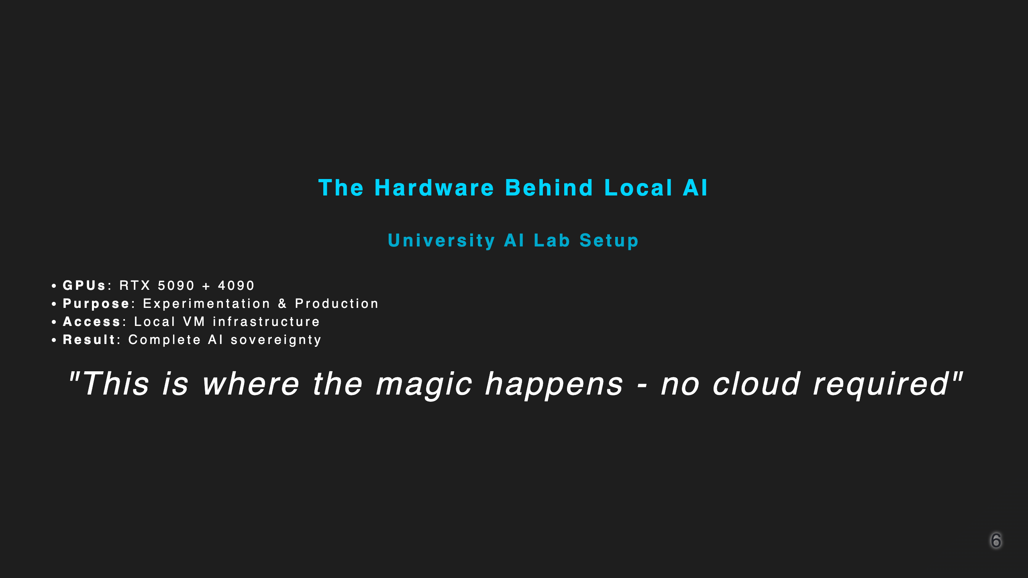
Notes:
Time: 5:00-6:00

Slide 7
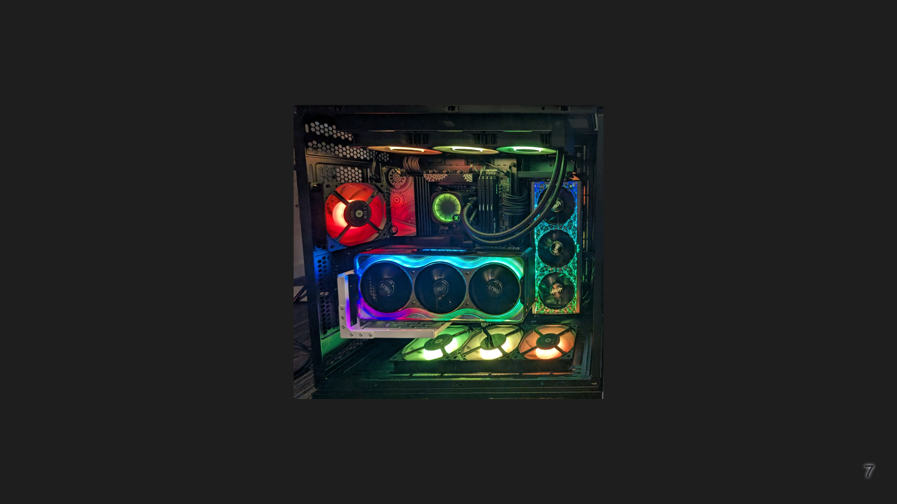

Slide 8
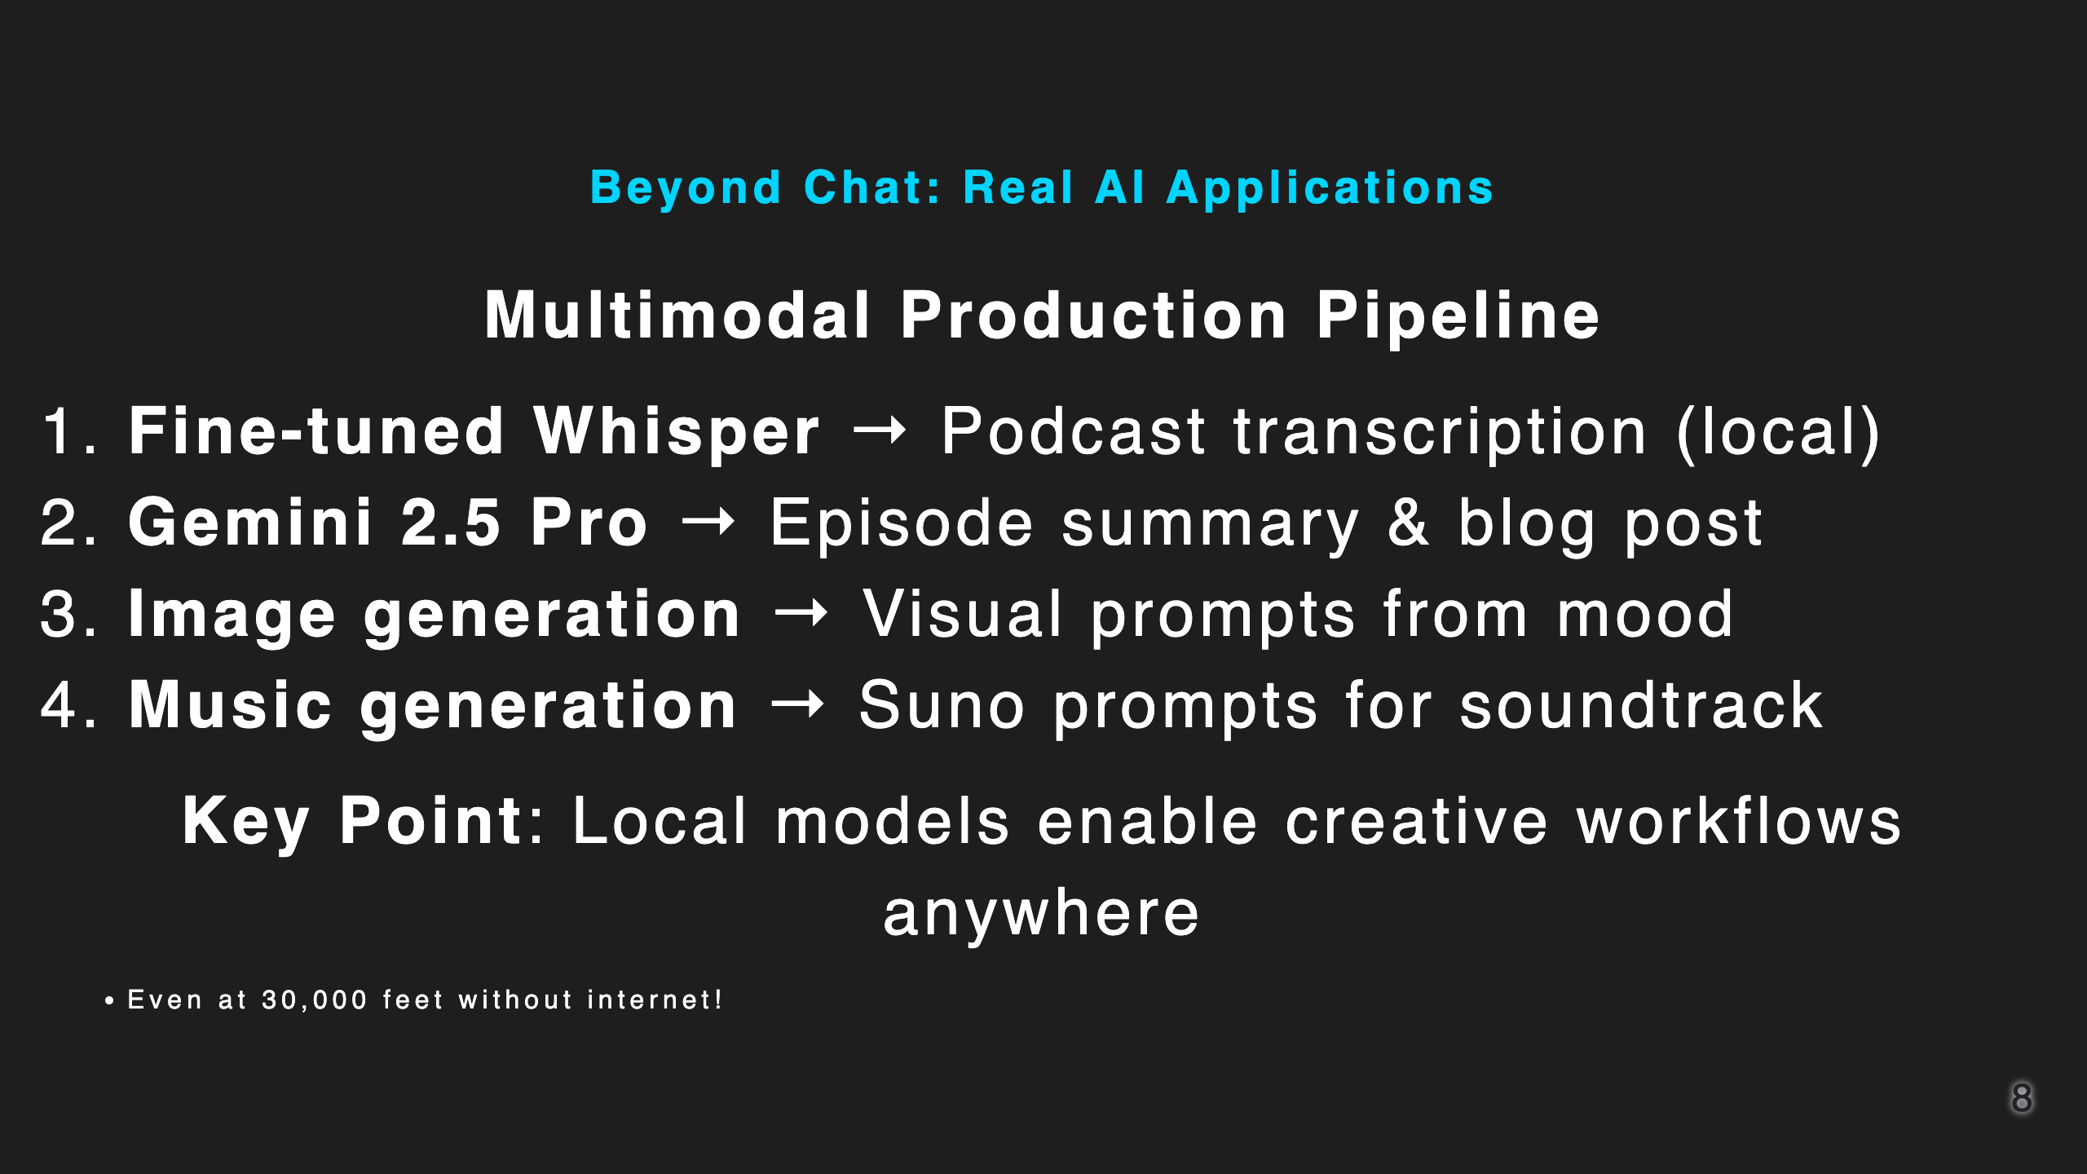
Notes:
Time: 6:00-7:00

Slide 9
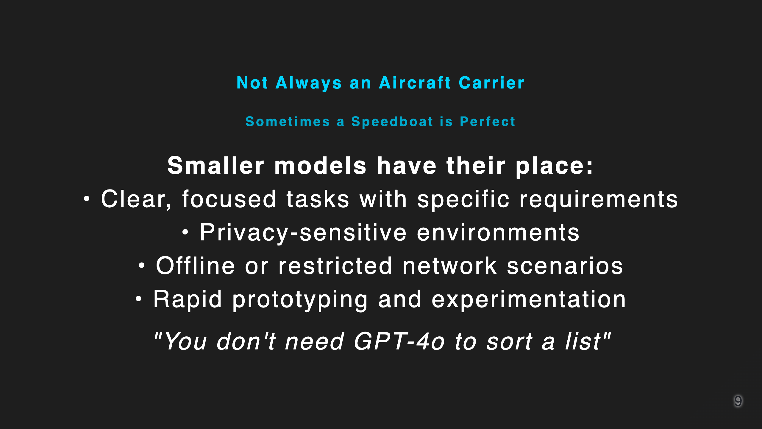
Notes:
Time: 7:00-8:00

Slide 10
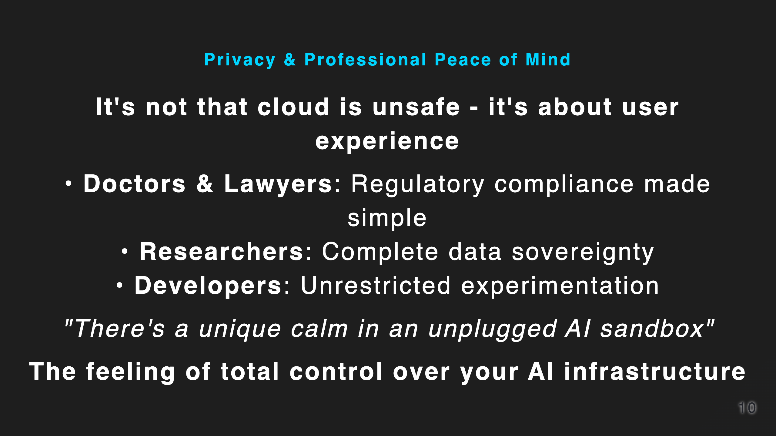
Notes:
Time: 8:00-9:00

Slide 11
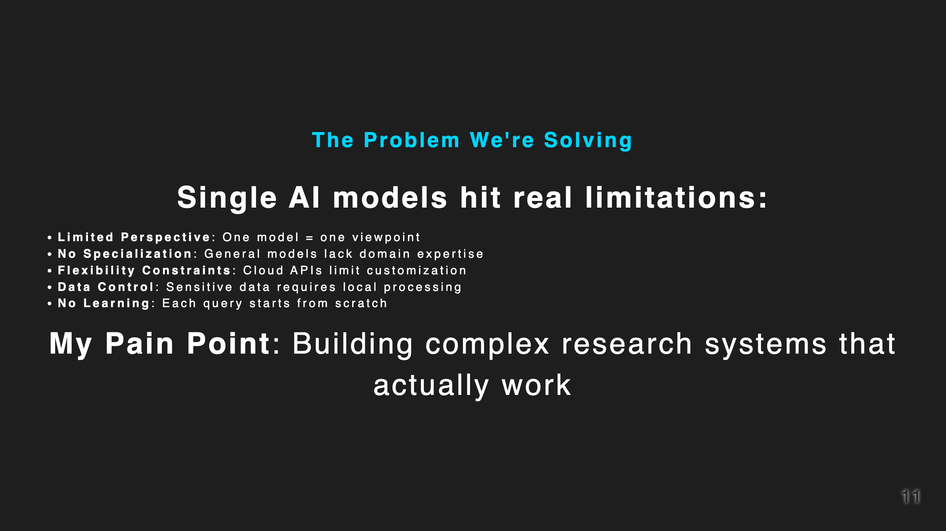
Notes:
Time: 9:00-10:00

Slide 12

Notes:
Time: 10:00-11:30

Slide 13


Slide 14
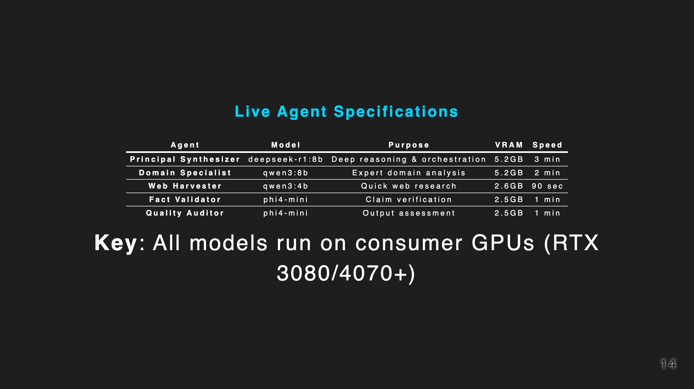
Notes:
Time: 11:30-13:00

Slide 15
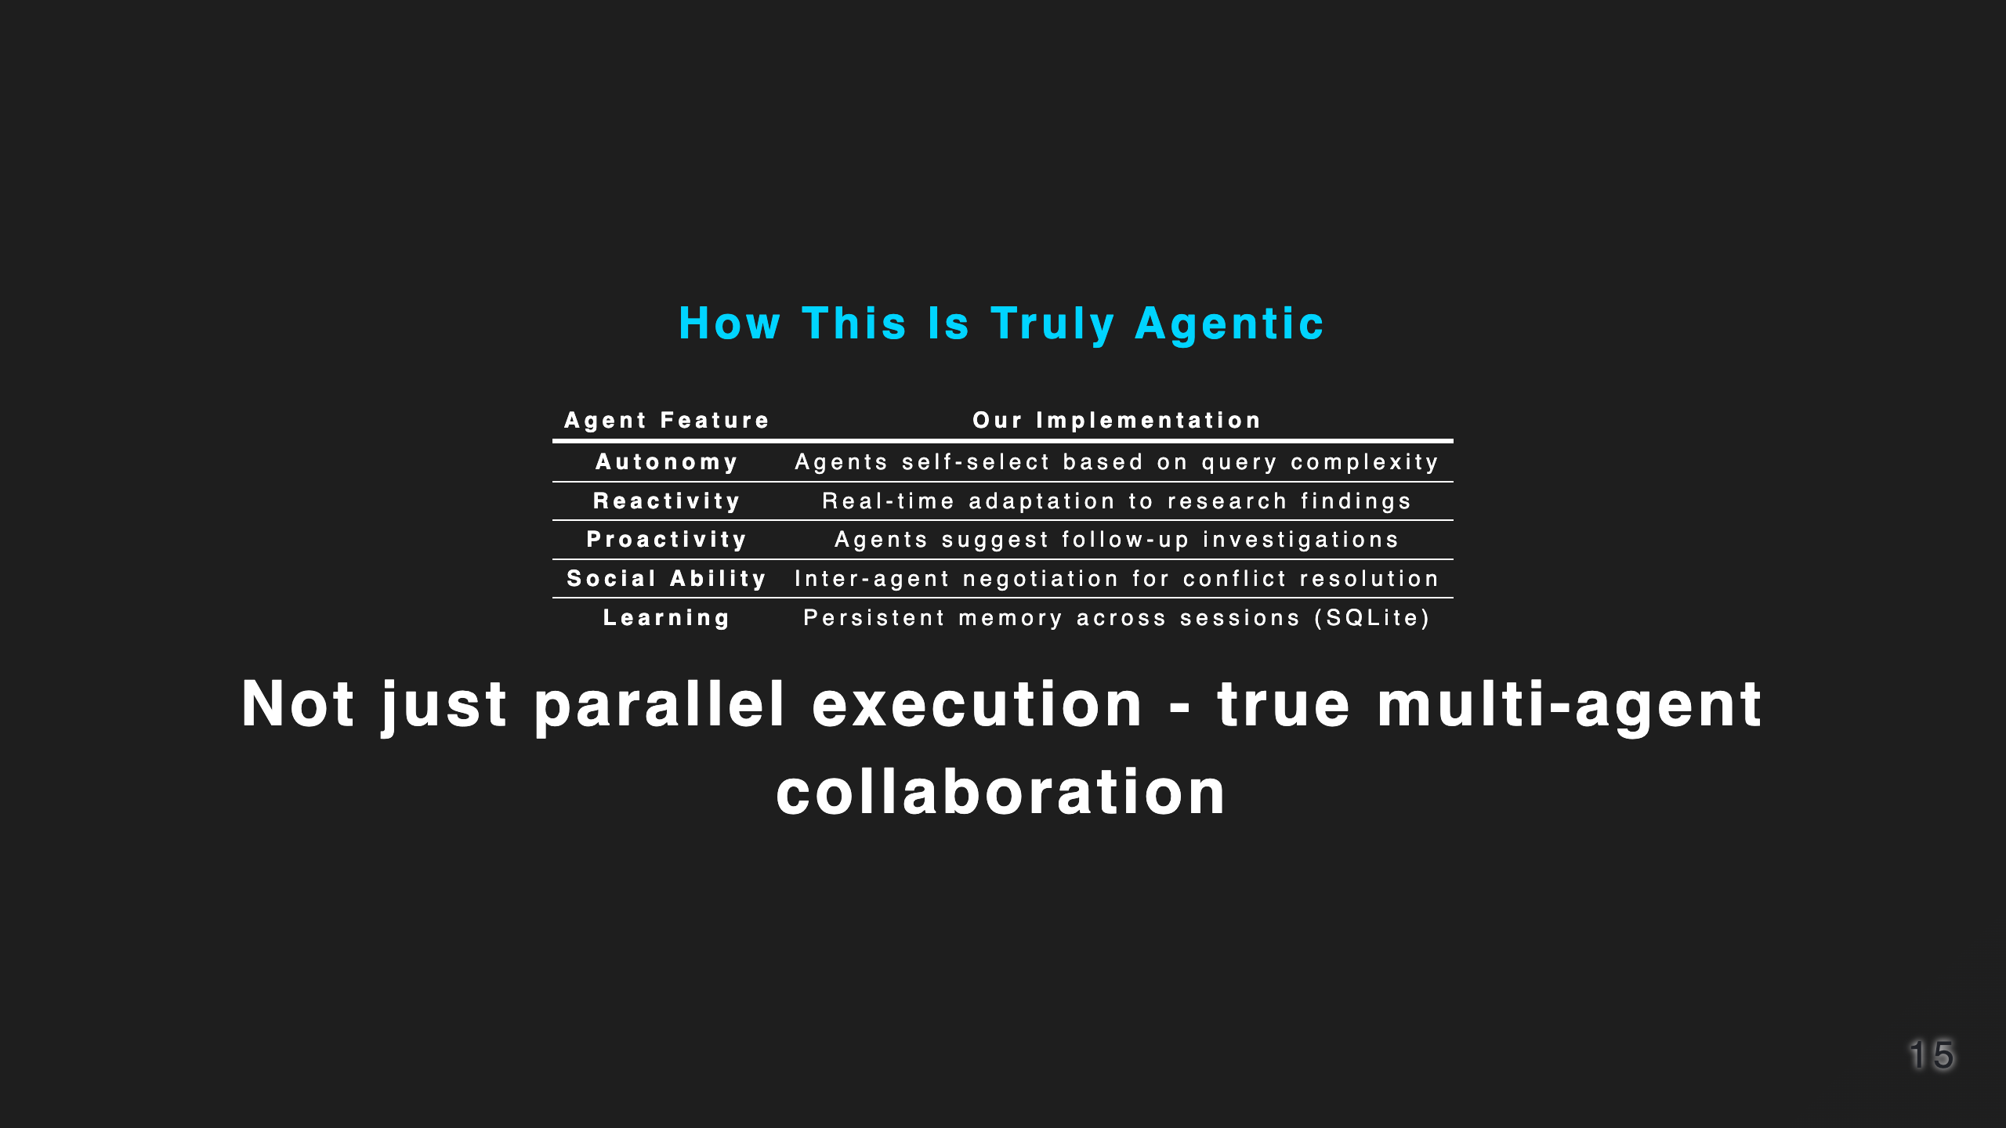
Notes:
Time: 13:00-14:30

Slide 16
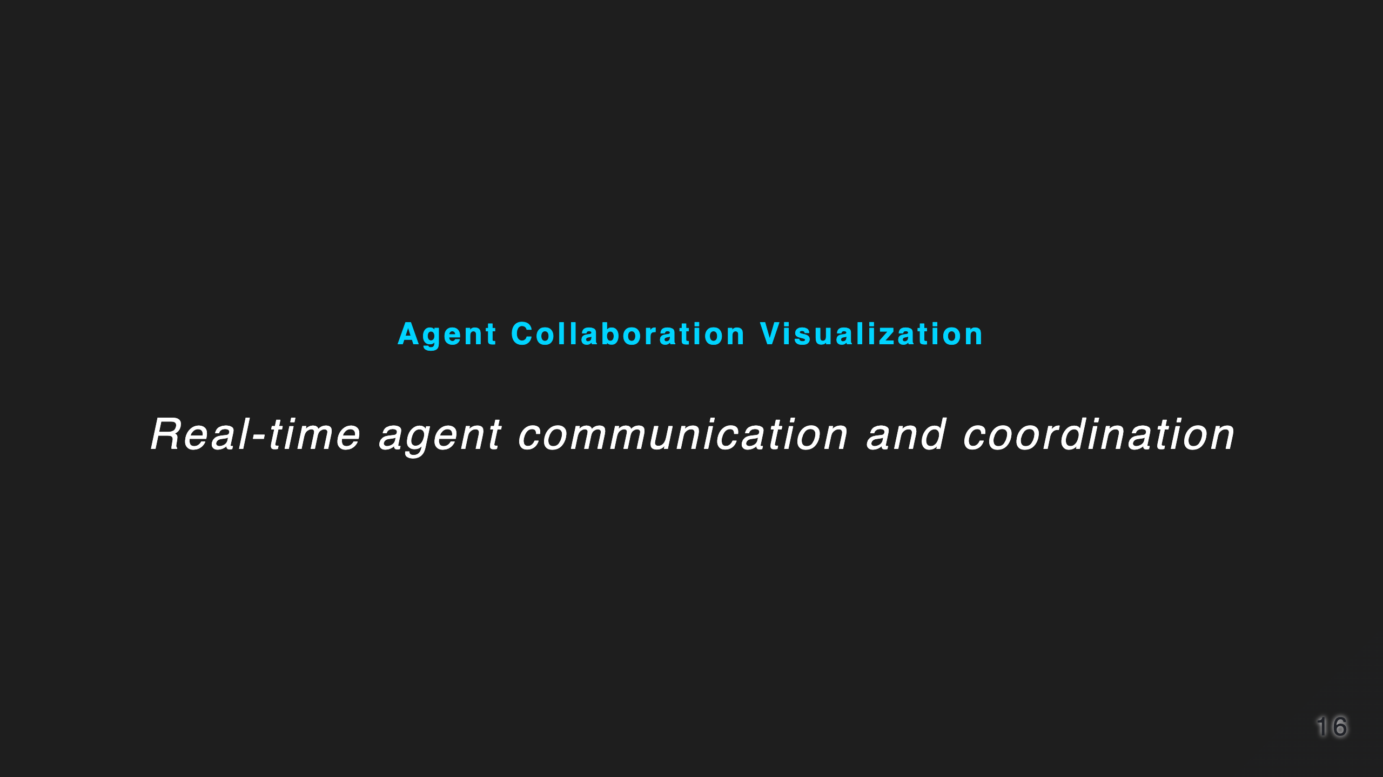
Notes:
Time: 14:30-15:30

Slide 17

Notes:
Time: 15:30-17:00

Slide 18
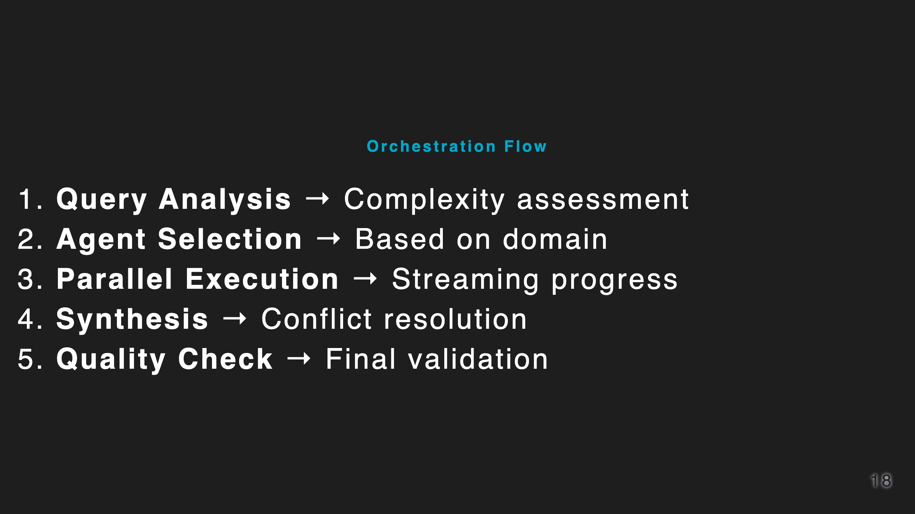

Slide 19
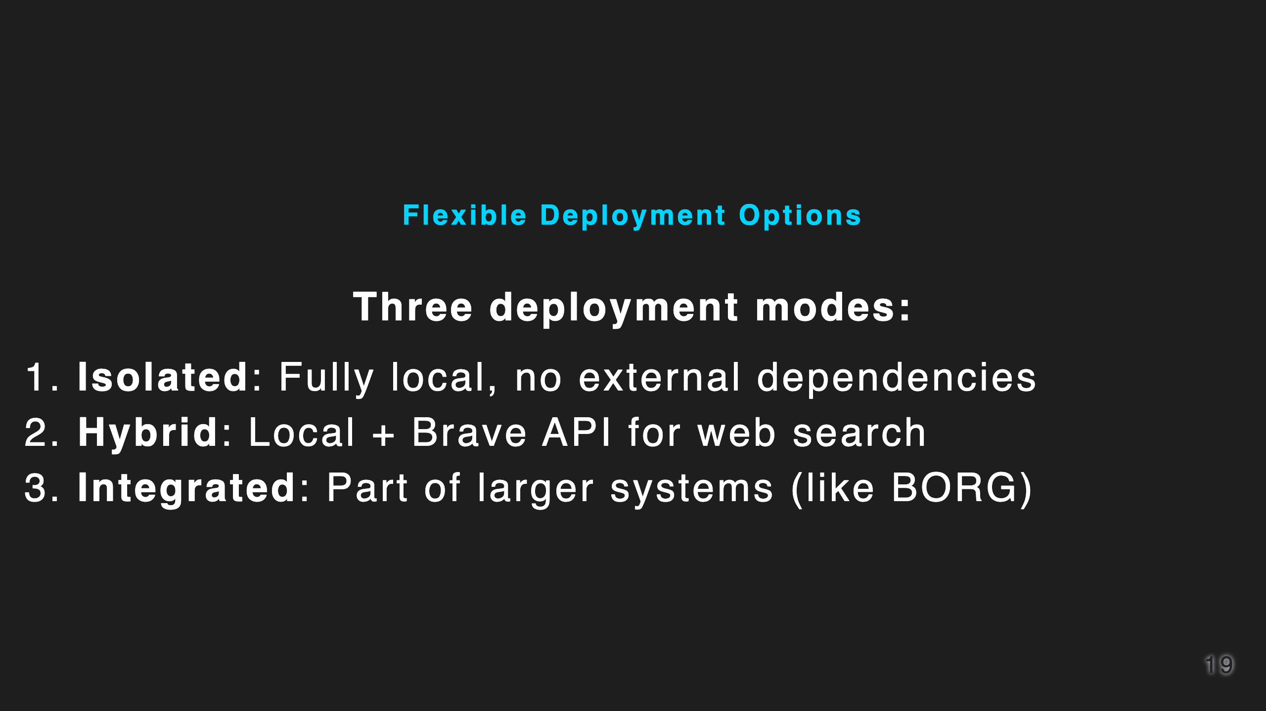
Notes:
Time: 17:00-18:00

Slide 20
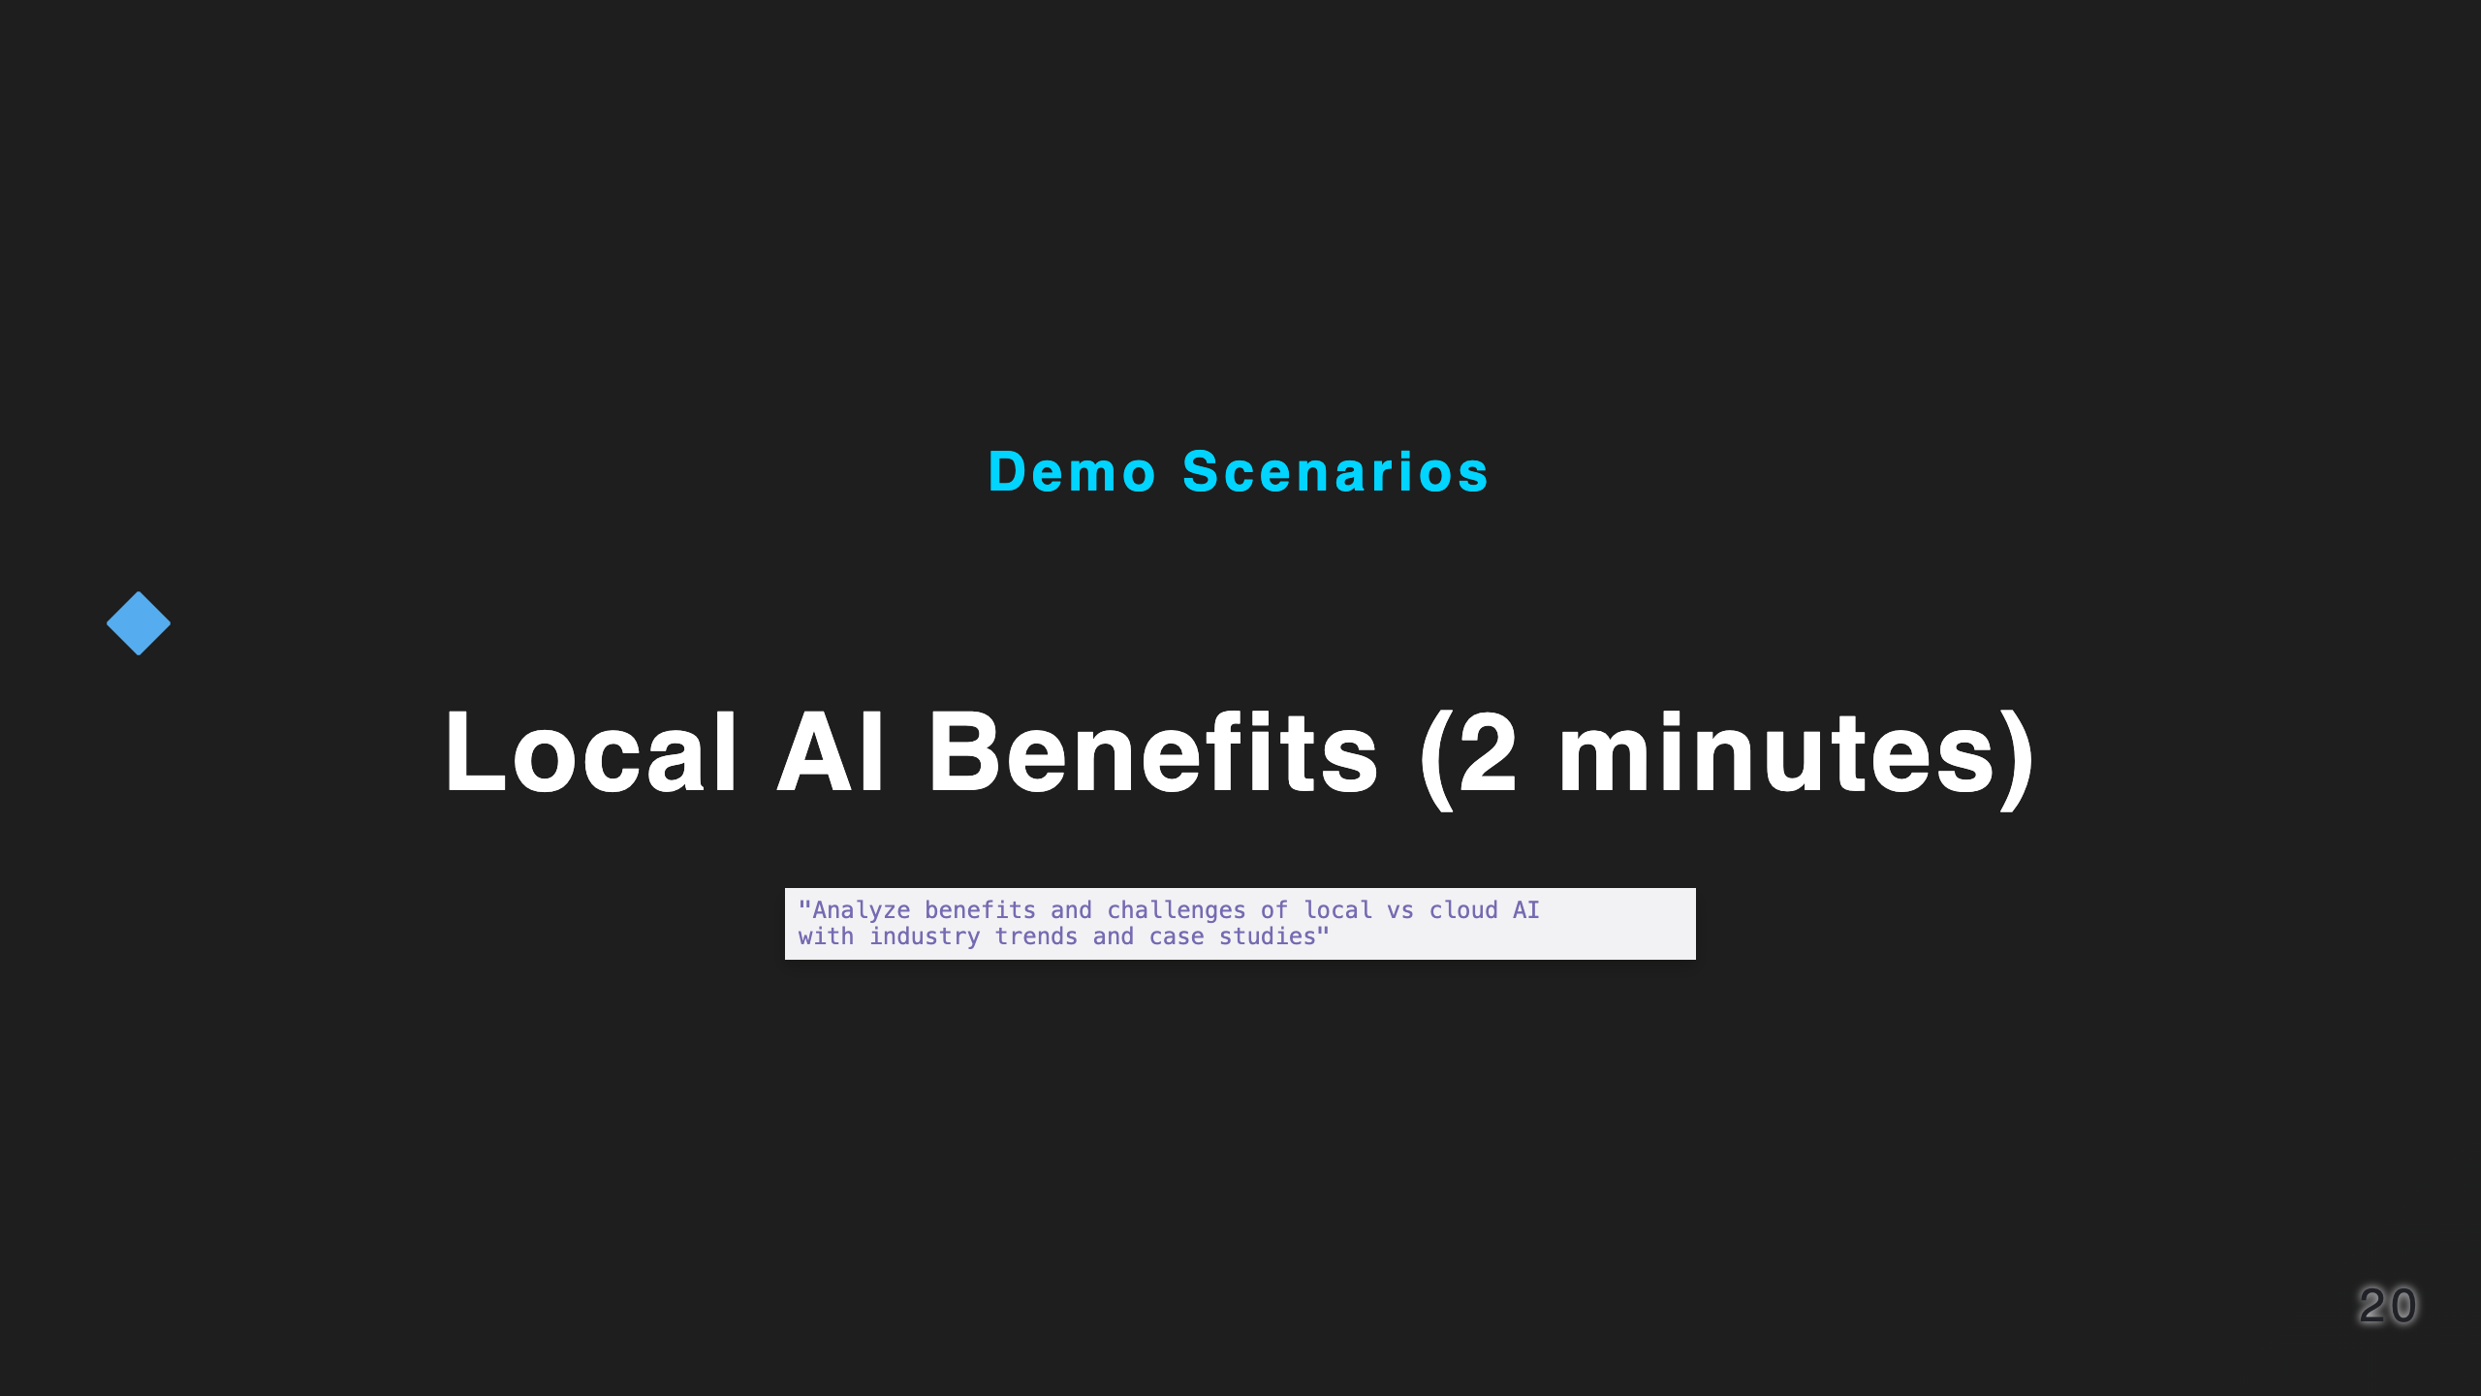
Notes:
Time: 18:00-19:00

Slide 21
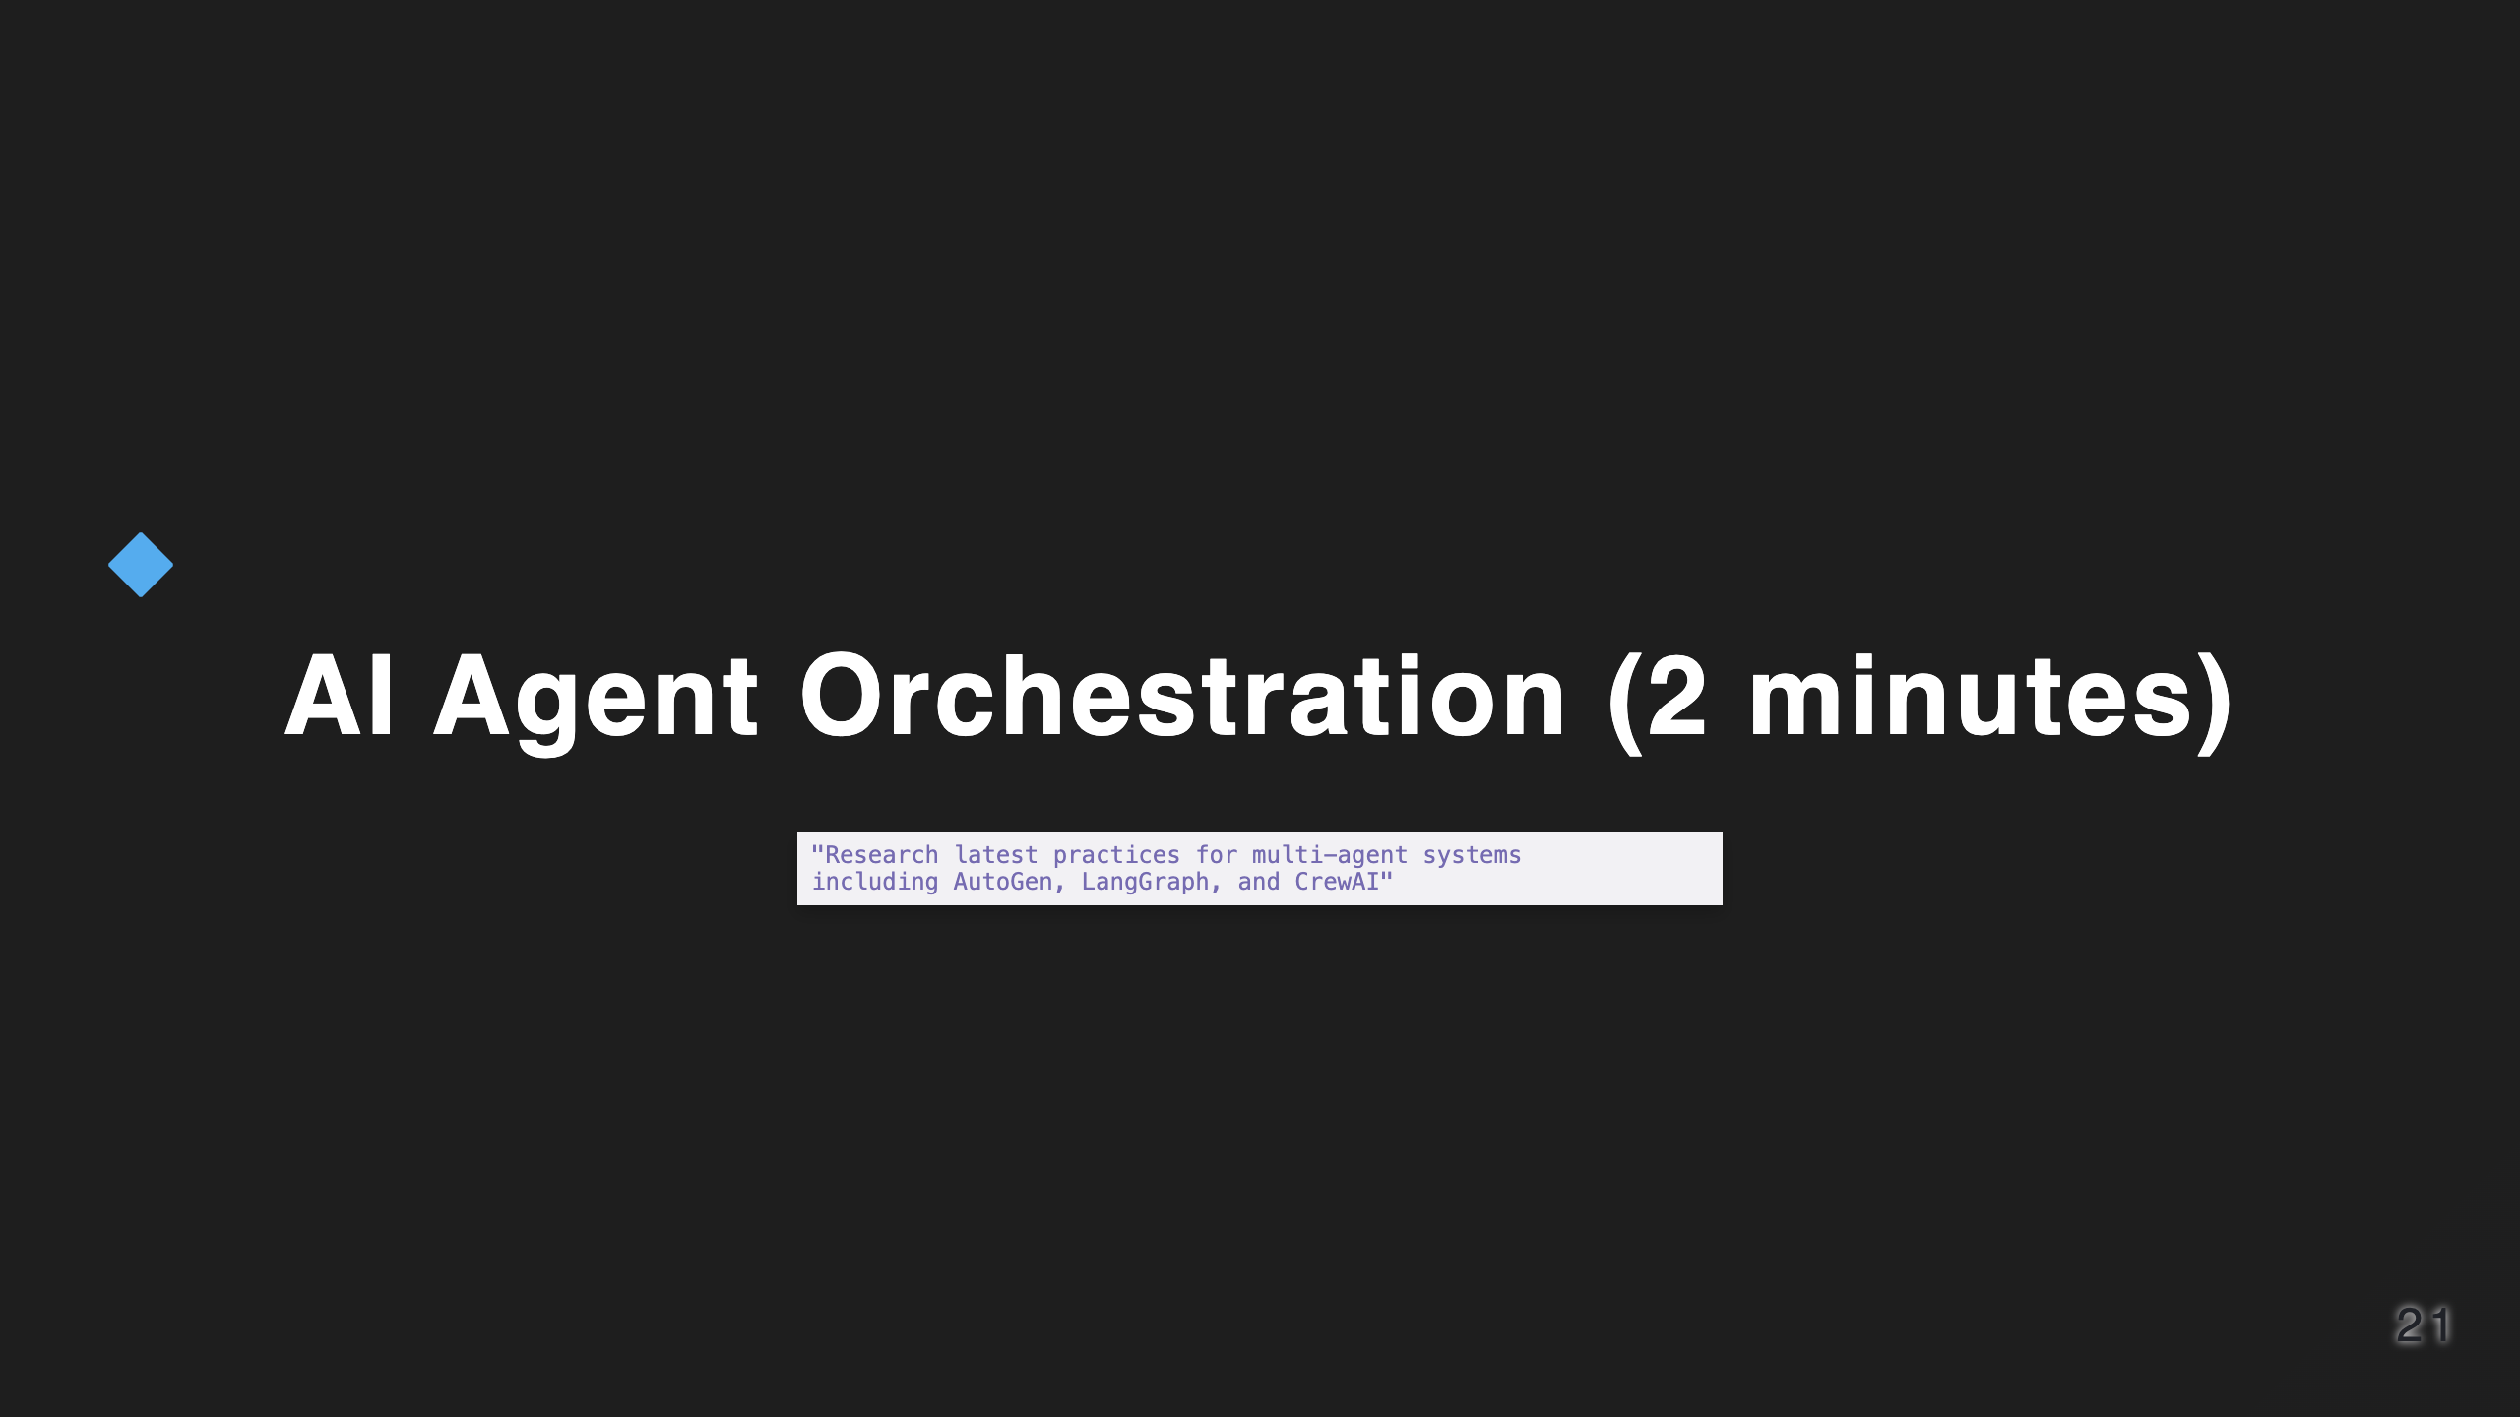

Slide 22


Slide 23

Notes:
Time: 19:00-25:00 Full screen for actual demo

Slide 24
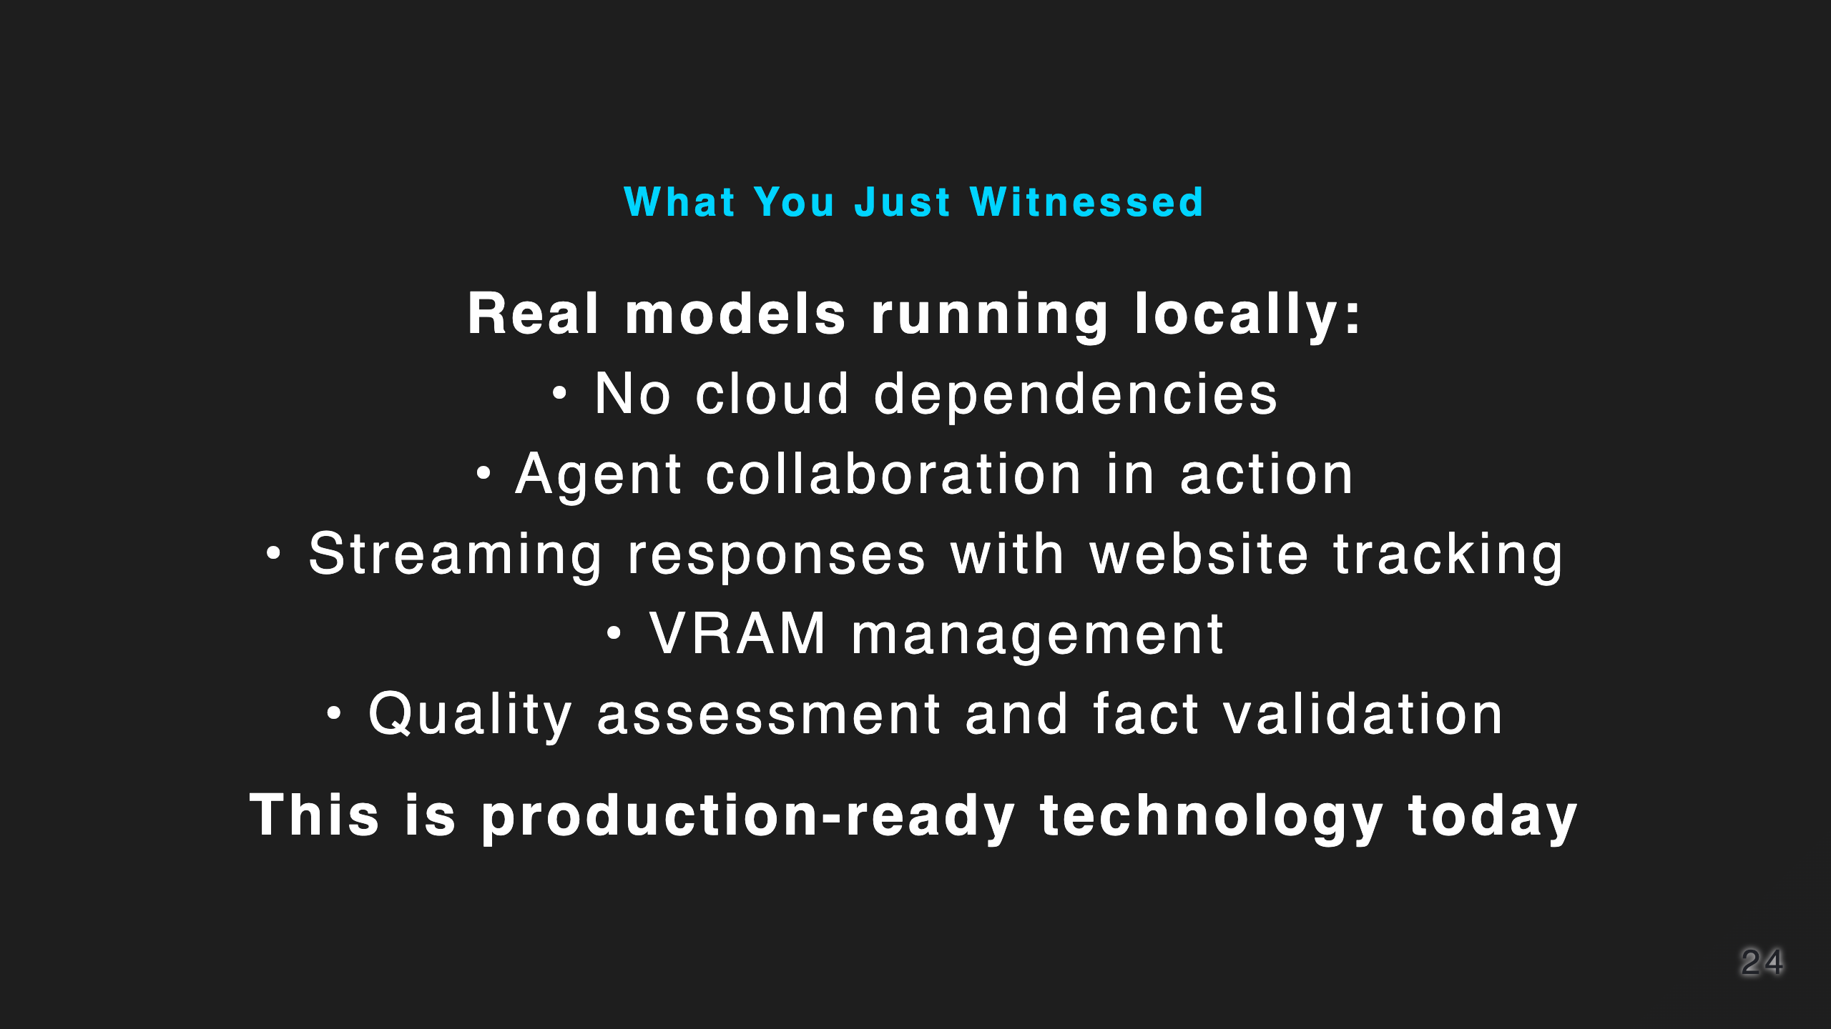
Notes:
Time: 25:00-26:00

Slide 25

Notes:
Time: 26:00-27:00

Slide 26
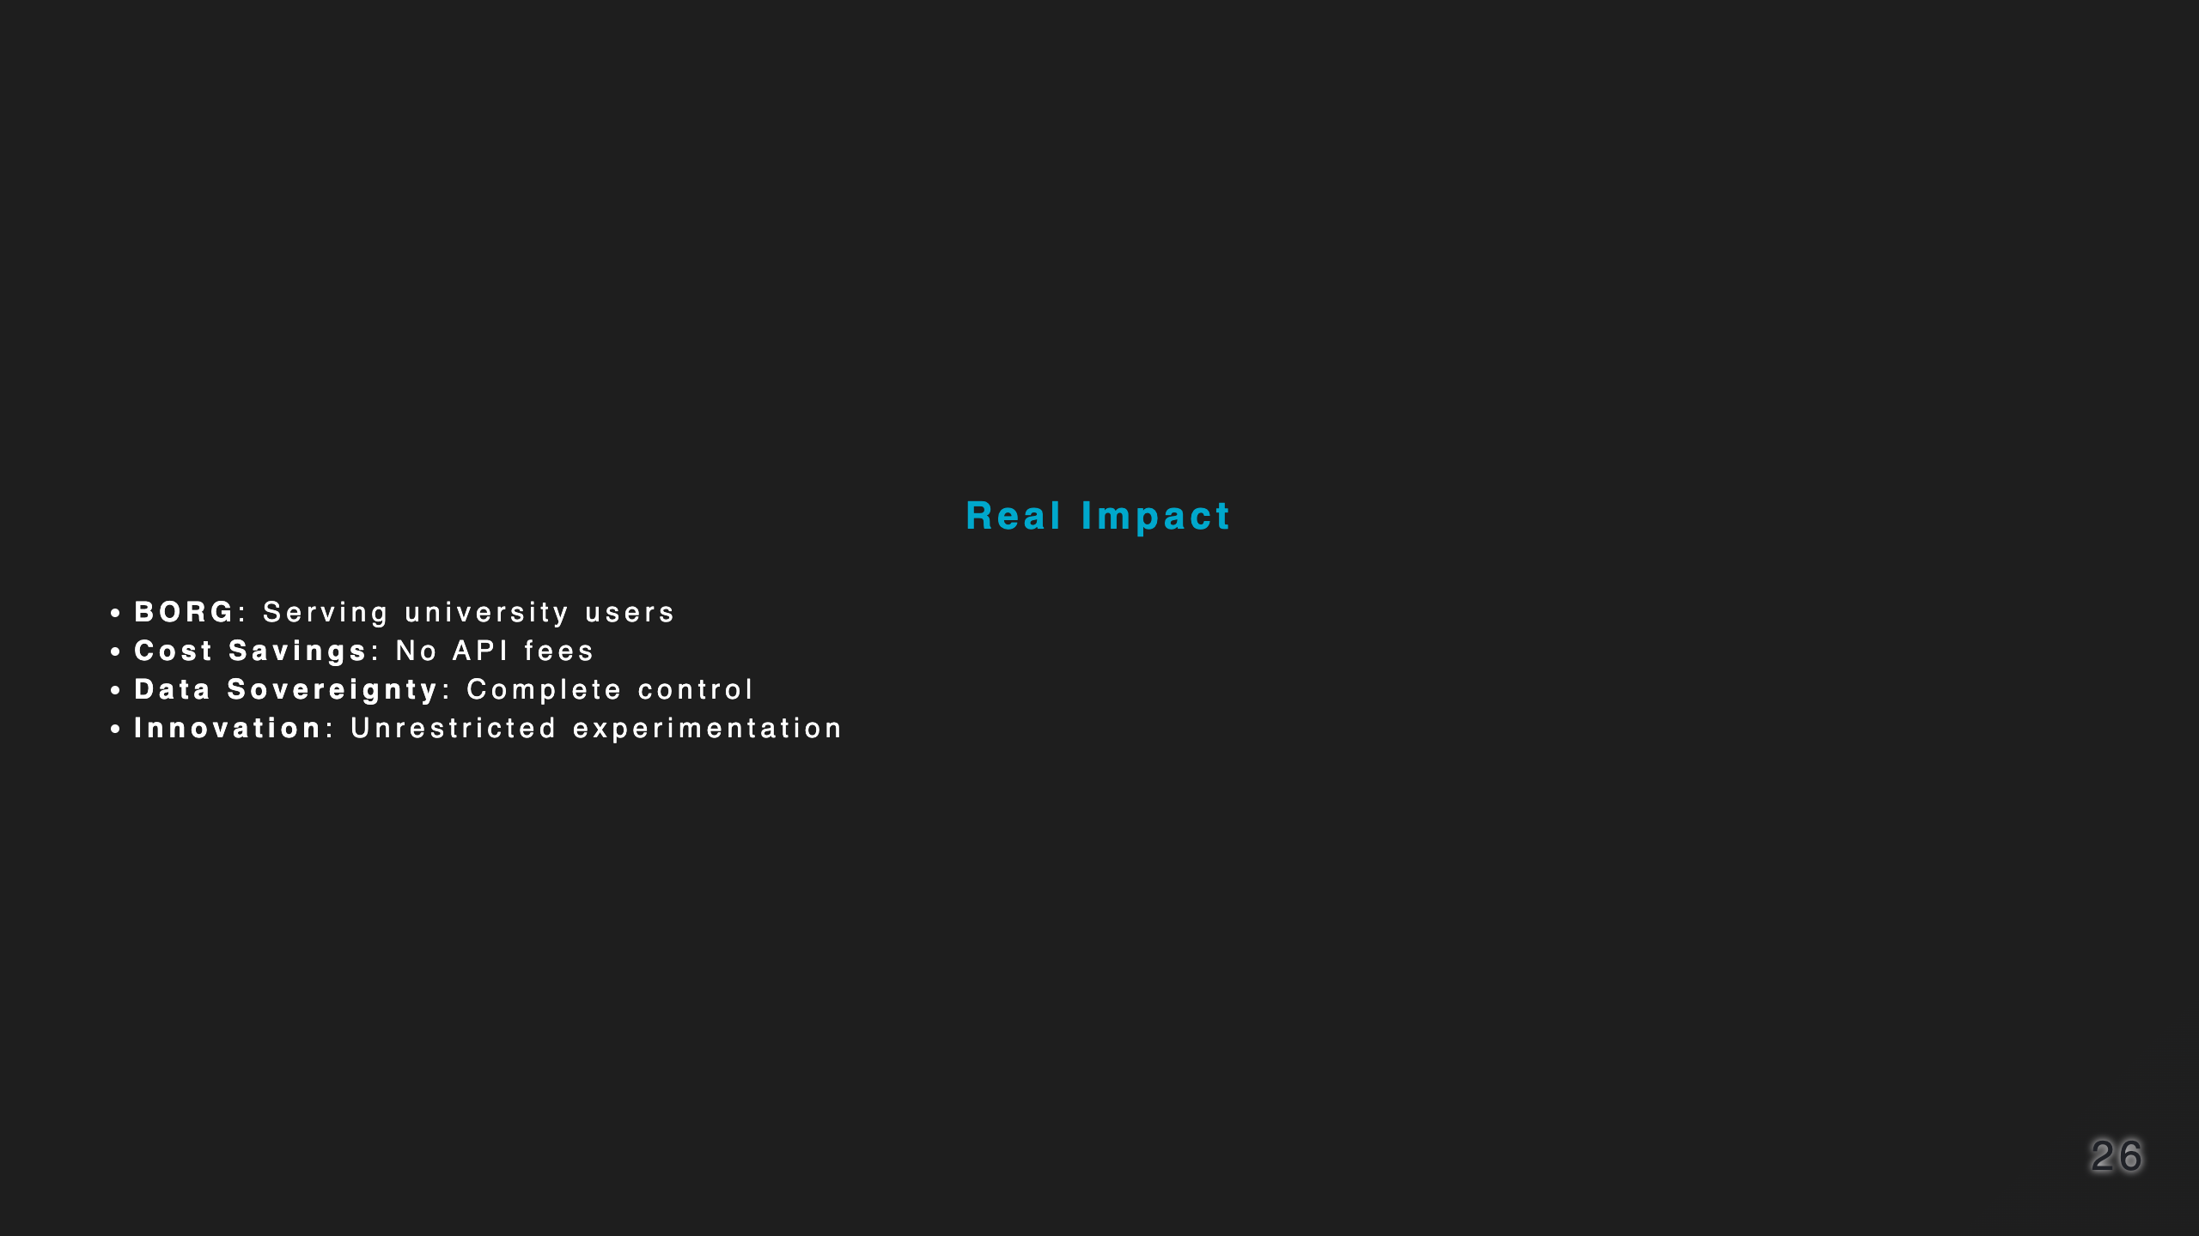

Slide 27

Notes:
Time: 27:00-28:00

Slide 28
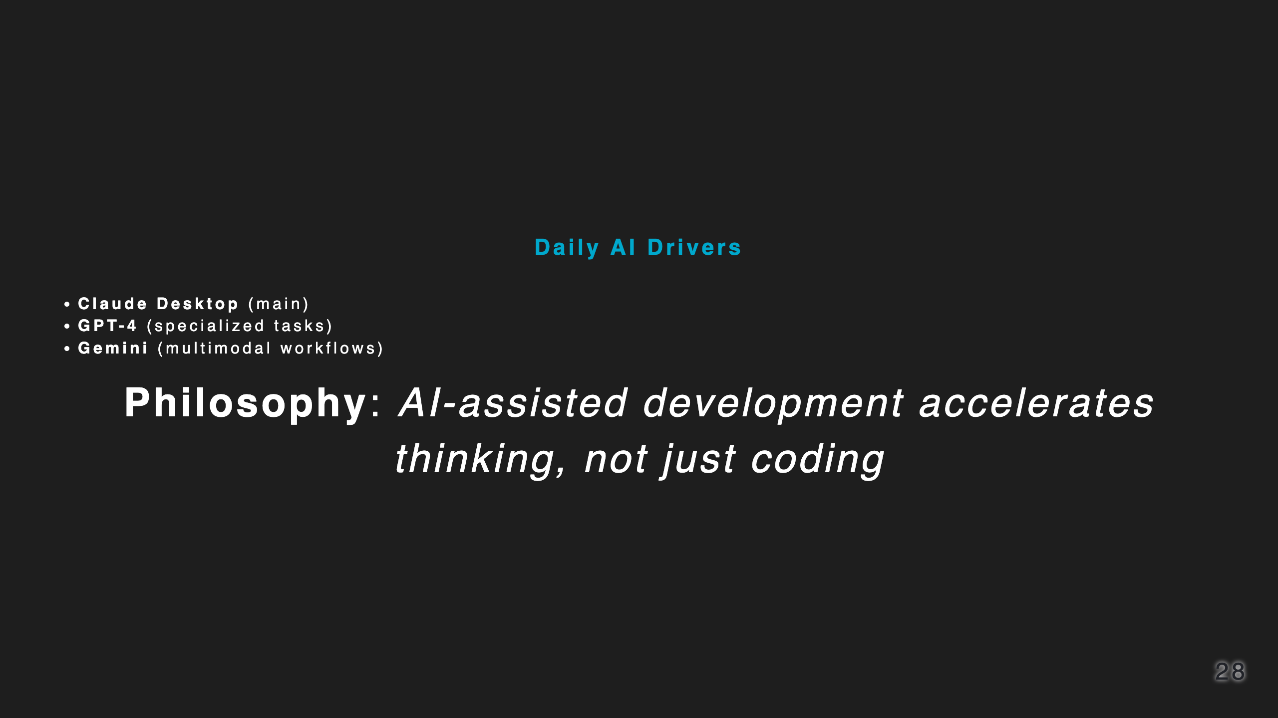

Slide 29
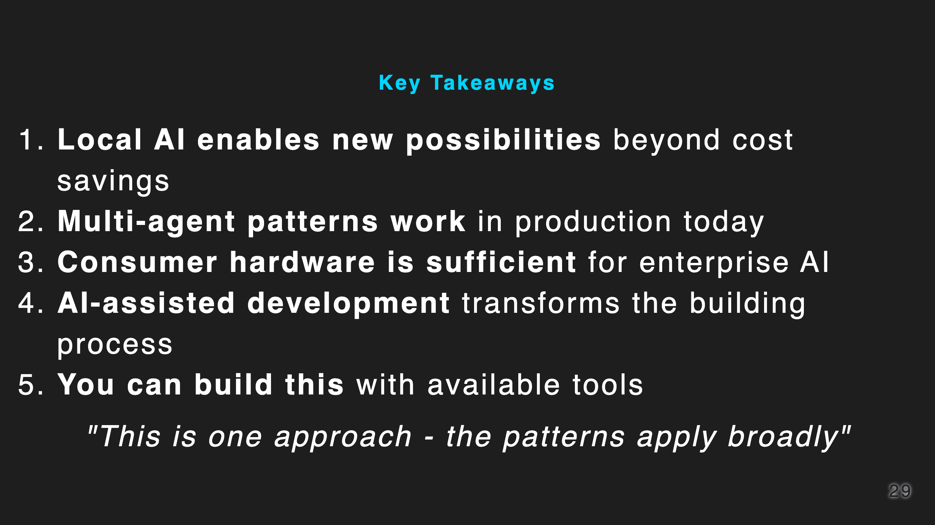
Notes:
Time: 28:00-29:00

Slide 30
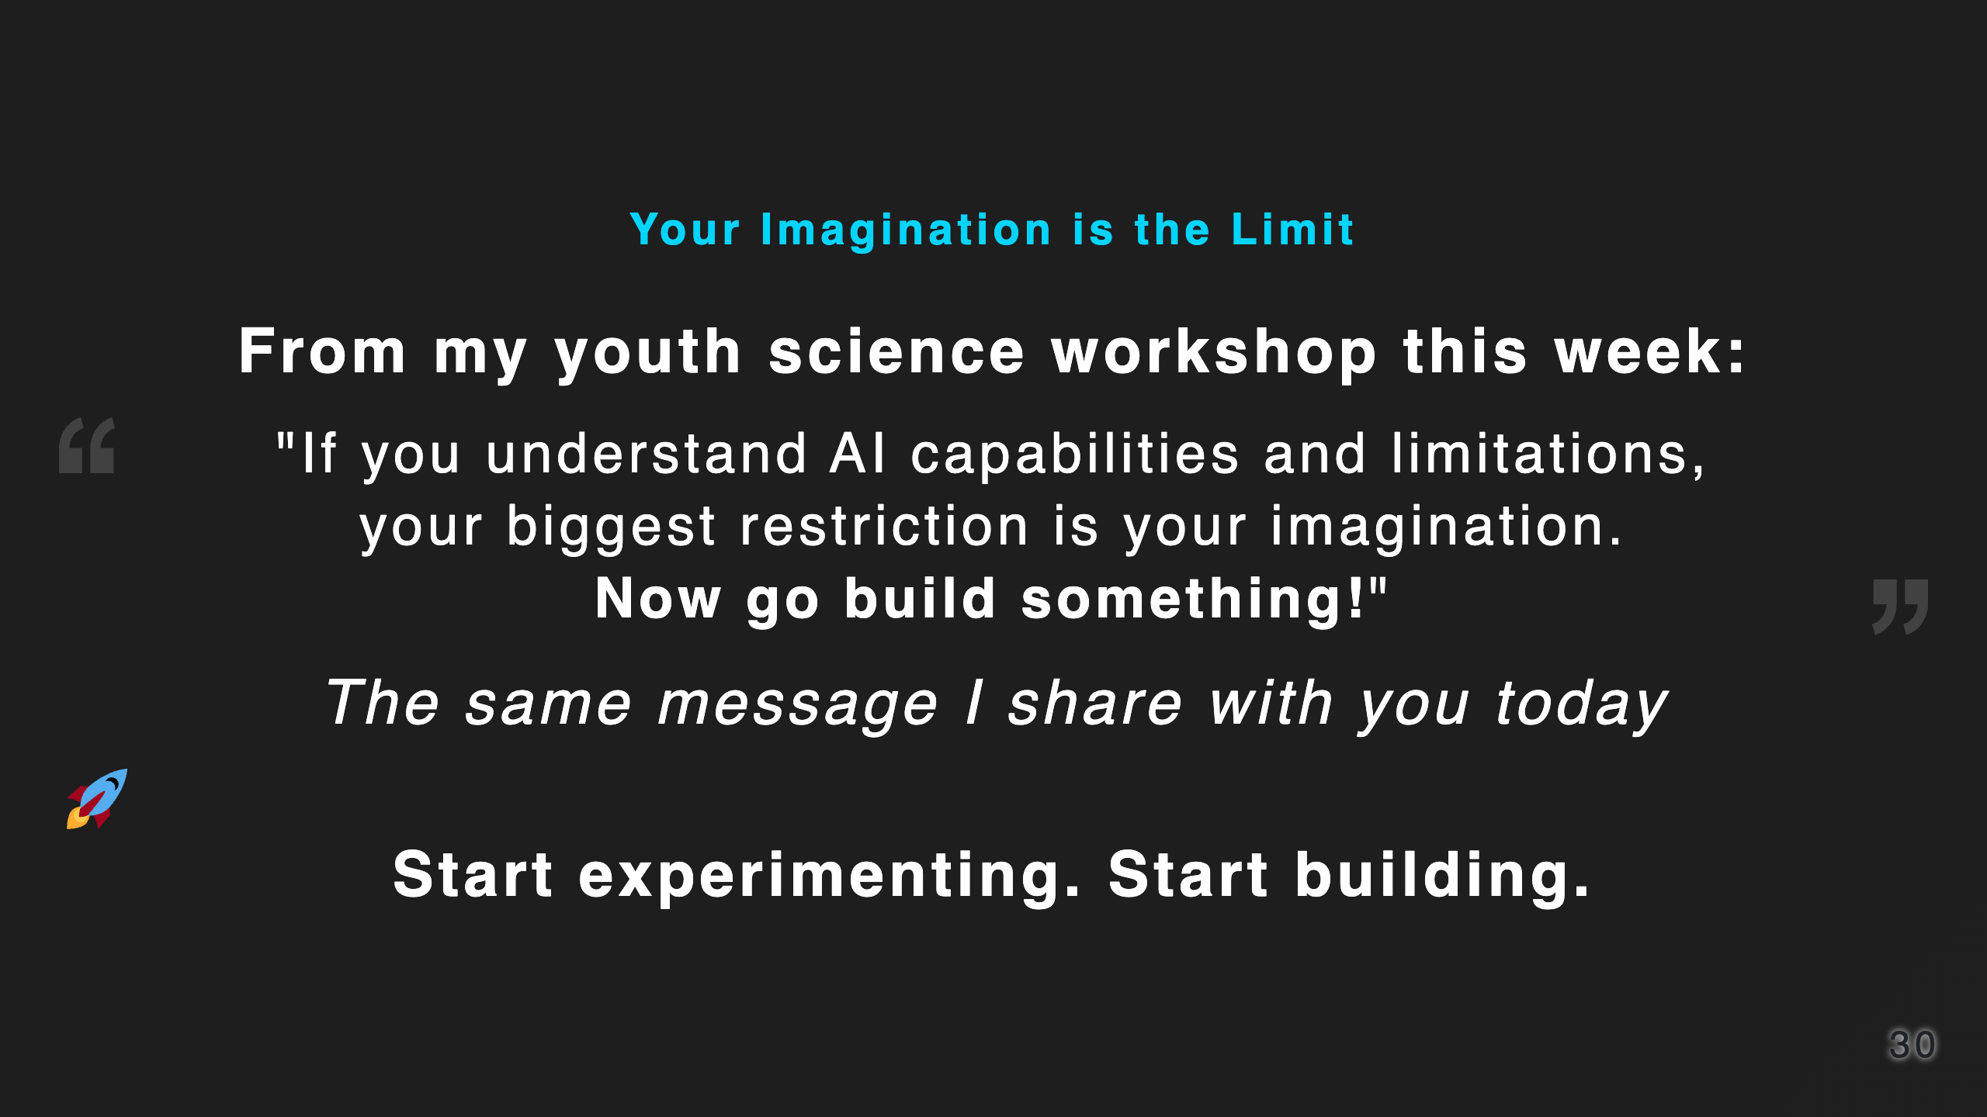
Notes:
Time: 29:00-29:30

Slide 31
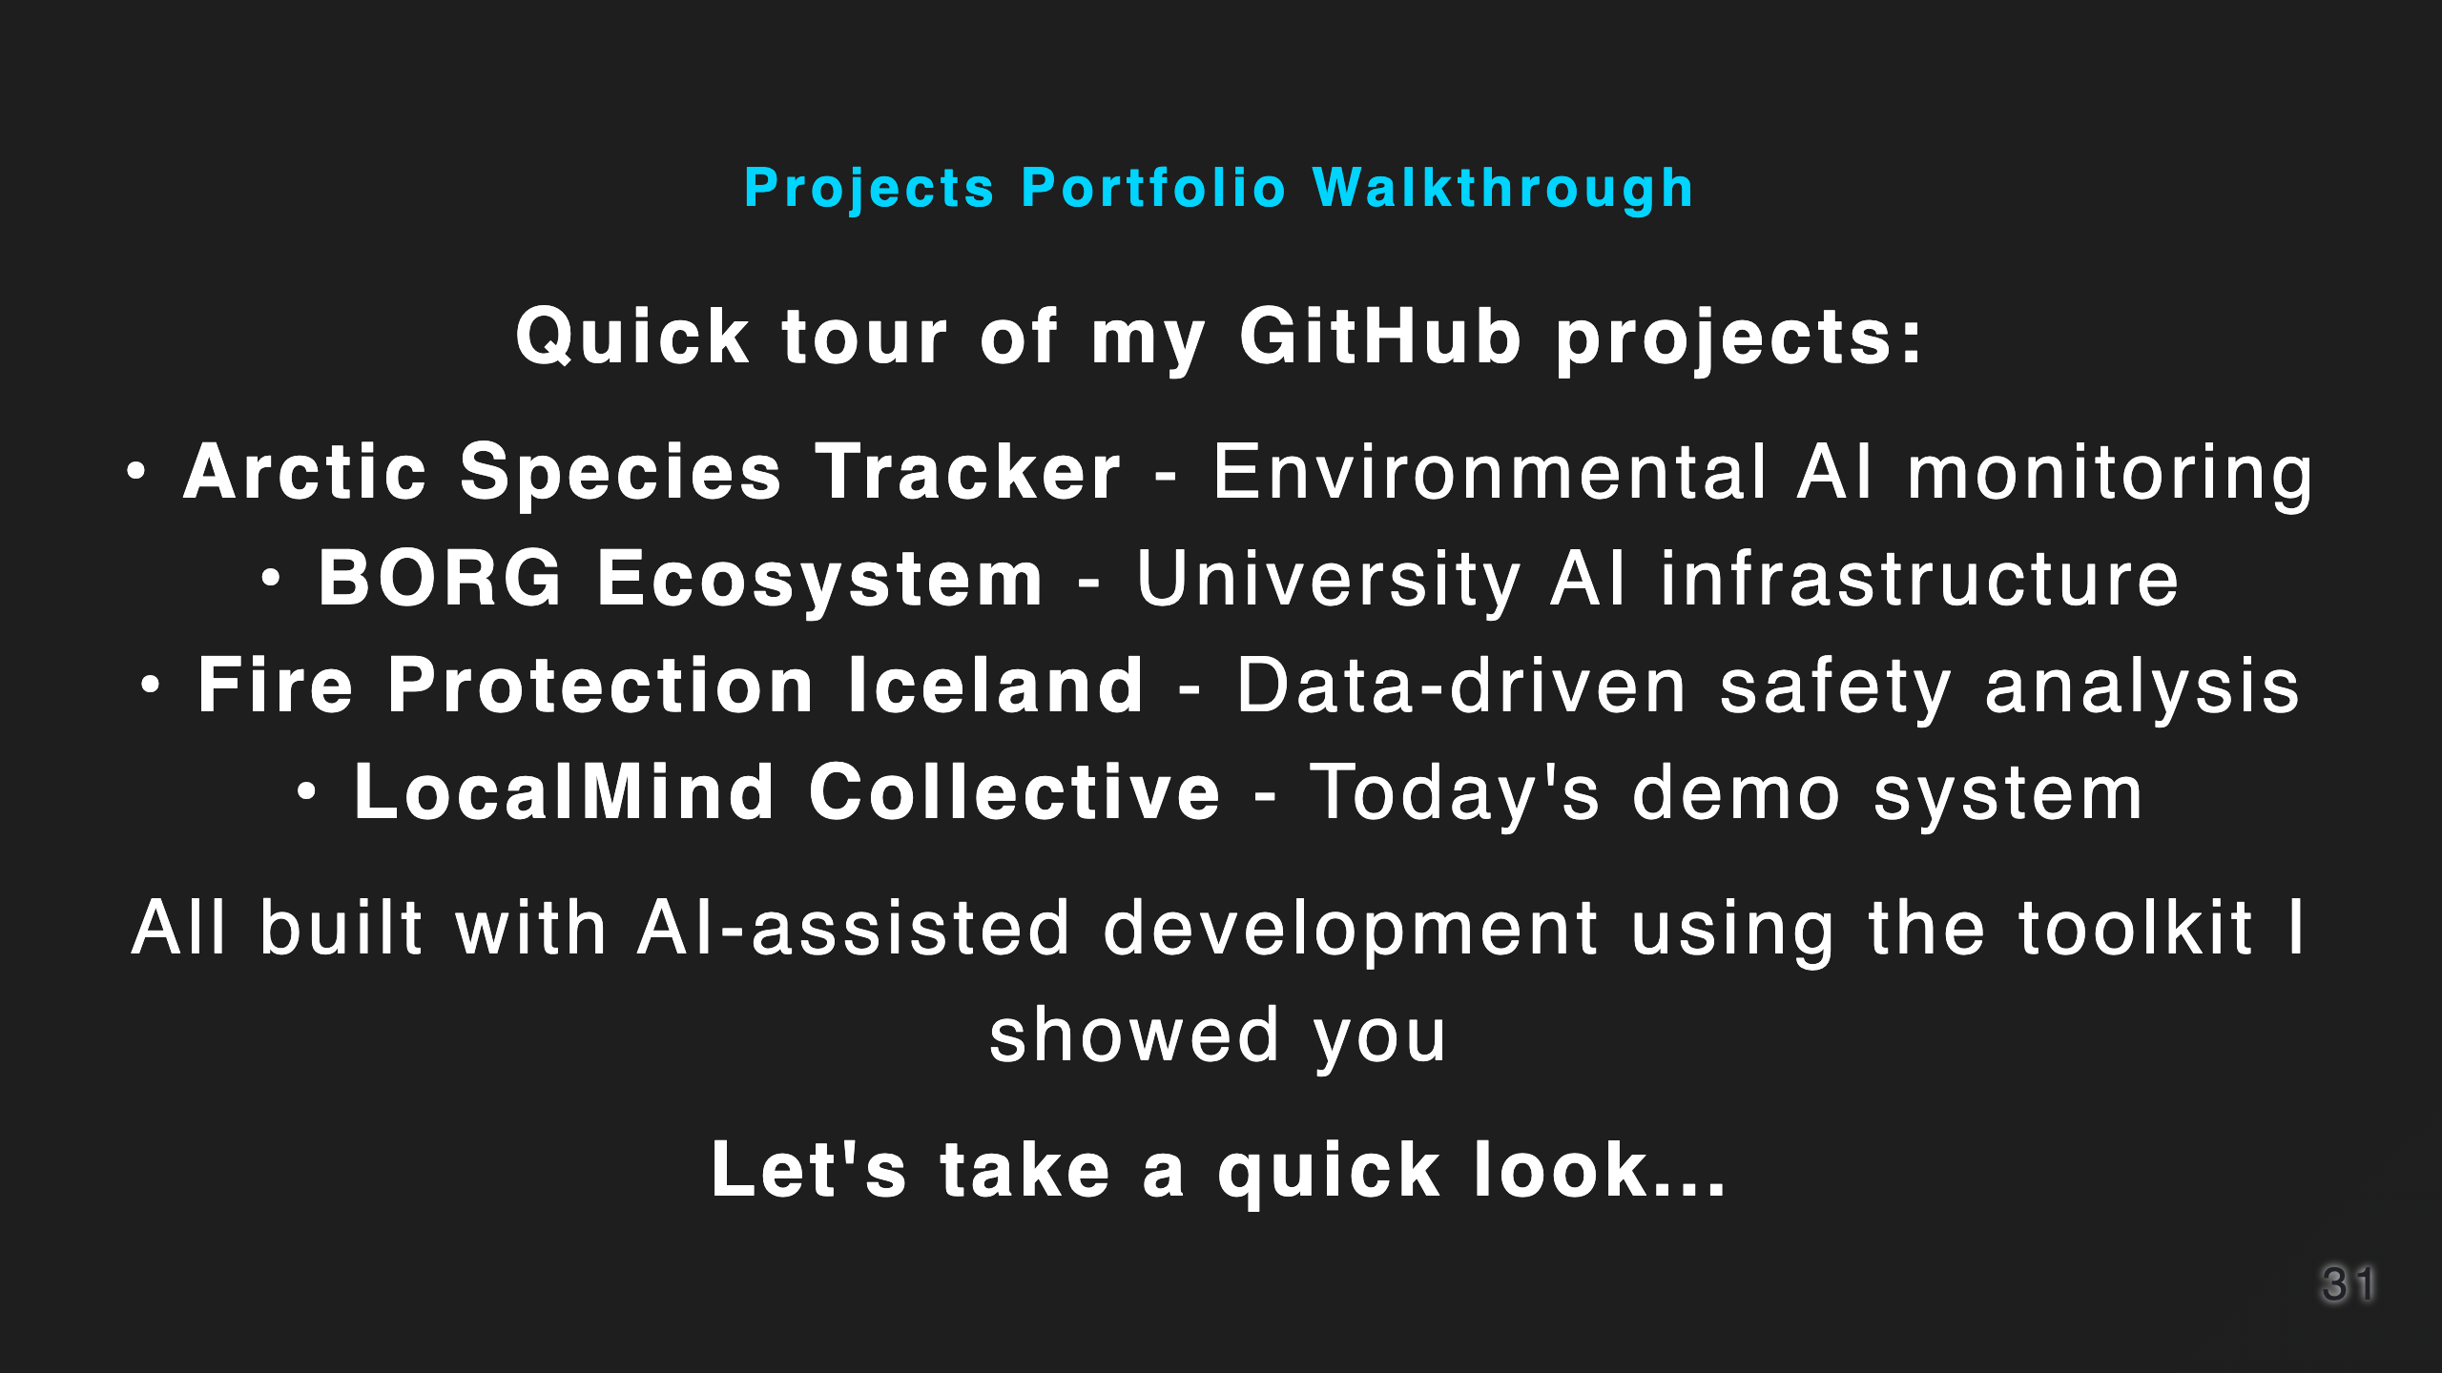
Notes:
Time: 29:30-30:00

Slide 32


